Slide 1

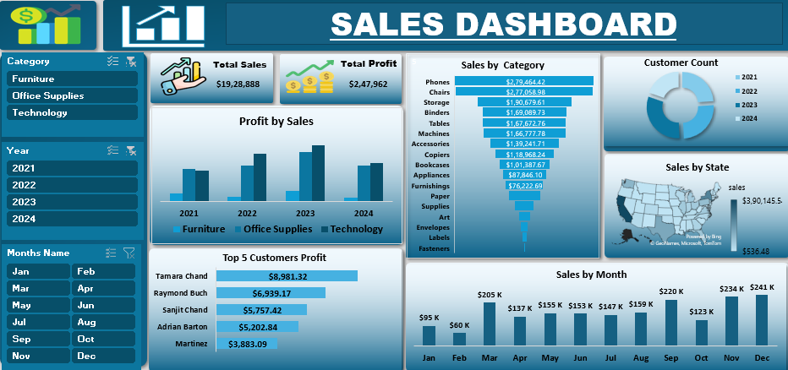
Sales & Profit Dashboard Using Microsoft Excel

Slide 2
Overviews
OBJECTIVES
DATA PROCESSING
PLOATING PIVOT AND CHART
A) Profit by sales
B) Sales by category
C) Customer count
D) Sales by state
E) Top 5 Customer Profit
F) Sales by Months
FILTER USED BY SLIDER
  A) Category B) Year C) Months
CARDS CREATION
CONCLUSION
RECOMMENDATION

Slide 3
OBJECTIVES
1. Monitor Overall Sales & Profit Performance
Provide a quick and accurate snapshot of total sales and total profit across selected time periods to support data-driven business decisions.
2. Analyze Sales and Profit Trends Over Time
Track year-wise and month-wise performance to identify growth patterns, seasonal trends, and fluctuations in sales and profitability.
3. Evaluate Product Category Performance
Break down sales and profit by category (Furniture, Office Supplies, Technology) to understand which product groups drive revenue and which need improvement.
4. Identify Top-Performing Customers
Highlight the highest-profit customers to help the business focus on key relationships and develop targeted retention strategies.
5. Understand Regional Sales Distribution
Visualize sales by state/region to uncover strong and weak markets, enabling better resource allocation and regional strategies.
6. Provide Interactive Filtering for Deep Analysis
Allow users to slice data by Category, Year, and Month to conduct detailed and customized analysis based on business needs.

Slide 4
DATA PROCESSING
1. Data Collection
Import raw sales data from Excel, CSV, or database sources.
Typical fields include:
Order Date, Customer Name, State, Category, Sub-Category, Product Name, Sales, Quantity, Profit, Year, Month.
2. Data Cleaning
Remove duplicates
Delete repeated rows to avoid distorted totals.
Handle missing values
Fill or remove rows where Sales/Profit values are missing.
Correct data types
Convert Order Date to Date type, numeric fields to float/int.
Fix inconsistent text
Ensure category, state, and customer names follow a standard format.
3. Data Transformation
Create new columns
  Year extracted from Order Date
  Month Name for month-wise visualizations
  Profit Margin = Profit / Sales

Slide 5
4. Data Filtering
Prepare slicers/filters for:
  Category
  Year
  Month
  These help users interact with the dashboard easily.
5. Data Integration
  Combine multiple tables (if any) using VLOOKUP, XLOOKUP, or Power Query merges.
  Ensure relationships between tables are correctly defined (in Power BI or Excel Data Model).
6. Data Validation
  Verify totals match the original source files.
  Check for negative or unrealistic profit values.
  Confirm that grouped results (e.g., Top 5 customers) are accurate.
7. Data Visualization Preparation
Convert processed data into a visualization-ready structure:
  Pivot Tables
  Measures (DAX, if Power BI)
  Aggregated tables for charts
  KPI cards data (Total Sales, Total Profit)

Slide 6
8. Dashboard Assembly
Use the cleaned & summarized data to build:
  Monthly Sales Chart
  Profit by Sales Chart
  Category-wise Sales Bar Chart
  Customer Count Donut Chart
  State Map Chart
  Top 5 Customers Profit
  KPI Cards (Sales + Profit)
9. Final Quality Check
  Check alignment, colors, labels, and slicer functionality.
  Validate formulas and pivot refresh behavior.
  Confirm dashboard updates automatically when data changes.

Slide 7
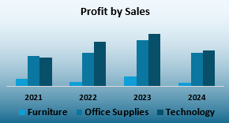
PLOATING PIVOT AND CHARTS
Profit by Sales (Clustered column chart)
Shows yearly comparison of sales and profit across categories to identify growth and category performance.

Slide 8
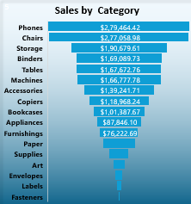
Sales by Category (funnel chart)
Highlights which product categories contribute the most revenue, helping identify top-selling items.

Slide 9
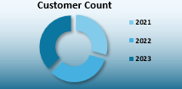
Customer Count (Donut Chart)
Displays the number of customers each year, showing growth or decline in customer base.

Slide 10
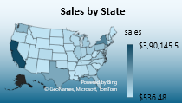
Sales by State (Map Chart)
Provides a geographical view of sales distribution, helping identify strong and weak regions.

Slide 11
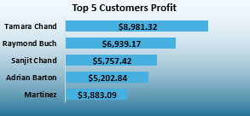
Top 5 Customers Profit (horizontal Bar chart)
Ranks customers by the profit they generate, helping target high-value clients.

Slide 12
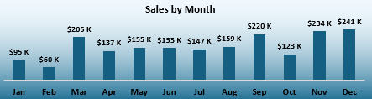
Sales by Month (Column chart)
Shows monthly performance trends and helps identify peak and low sales periods.

Slide 13

FILTER USE BY SLIDER
Category Slicer (Furniture, Office Supplies, Technology)
Helps filter all charts based on product categories to analyze specific segments.
Useful for comparing sales and profit across different product groups.

Slide 14
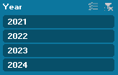
Year Slicer (2021, 2022, 2023, 2024)
Allows switching the dashboard view by year for quick trend comparison.
Helps track business growth and performance across multiple years.

Slide 15
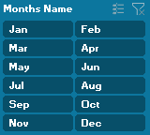
Months Name Slicer (Jan–Dec)
Filters data by month to study seasonal sales and profit patterns.
Useful for identifying peak months and low-performance periods.

Slide 16


CARDS CREATION
Total Sales Card
Shows the overall revenue generated for the selected period.
Helps quickly understand business performance at a glance.
Total Profit Card
Displays the total profit earned after deducting costs.
Useful for evaluating financial health and profitability instantly.

Slide 17
The Sales & Profit Dashboard provides a comprehensive view of business performance by combining key metrics, visual trends, and customer insights in one place. With interactive charts, slicers, and KPI cards, it allows decision-makers to quickly identify growth opportunities, monitor profitability, and make informed strategic decisions.
CONCLUSION

Slide 18
1. Focus on High-Profit Customers
Prioritize engagement and retention strategies for top customers contributing the most profit.
2. Improve Low-Performing Categories
Investigate categories with low sales or negative profit and optimize pricing, marketing, or inventory.
3. Expand in High-Sales Regions
Allocate more resources to states with strong sales performance to maximize growth opportunities.
4. Monitor Monthly Trends Closely
Use monthly sales patterns to plan promotions, manage stock, and prepare for seasonal demand.
5. Enhance Data Refresh & Automation
Implement automated updates to ensure the dashboard always reflects the latest business data.
RECOMMENDATIONS

Slide 19


